Slide 1
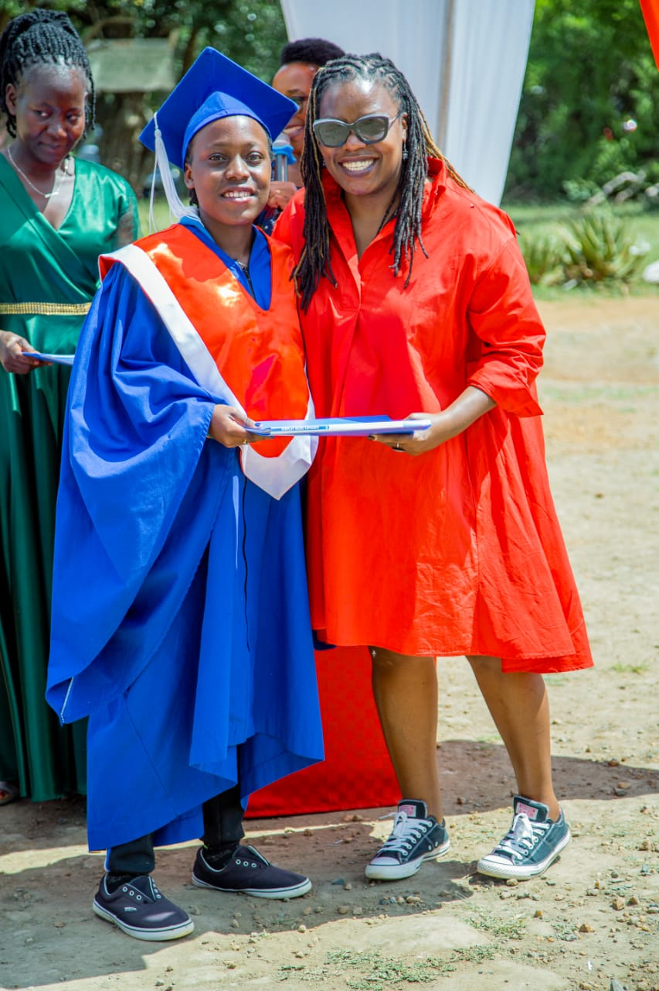
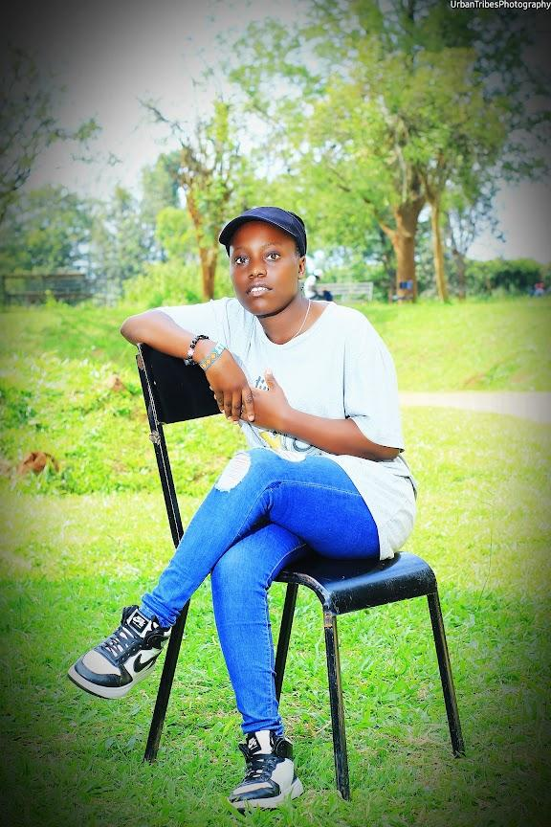
ALL ABOUT
USHI ADHIAMBO WAYOGA

Slide 2
Get to Know Me Better
I am 19 years old . I come from Kitale,Kenya a very interesting country to leave.I have done my schooling in Daraja High School in Nanyuki . Then I did my primary school in Lamplighter school. I have a protagonist personality. I am usually passionate because I take pleasure in pursuing things that I like.

Slide 3


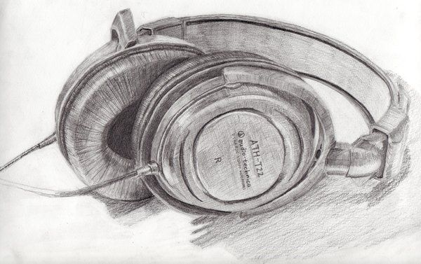
Things I Like
￼
Fish is my favorite meal
Drawing
Watching movies
Listening to music
Dancing
Playing handball
Reading romantic novels

Slide 4
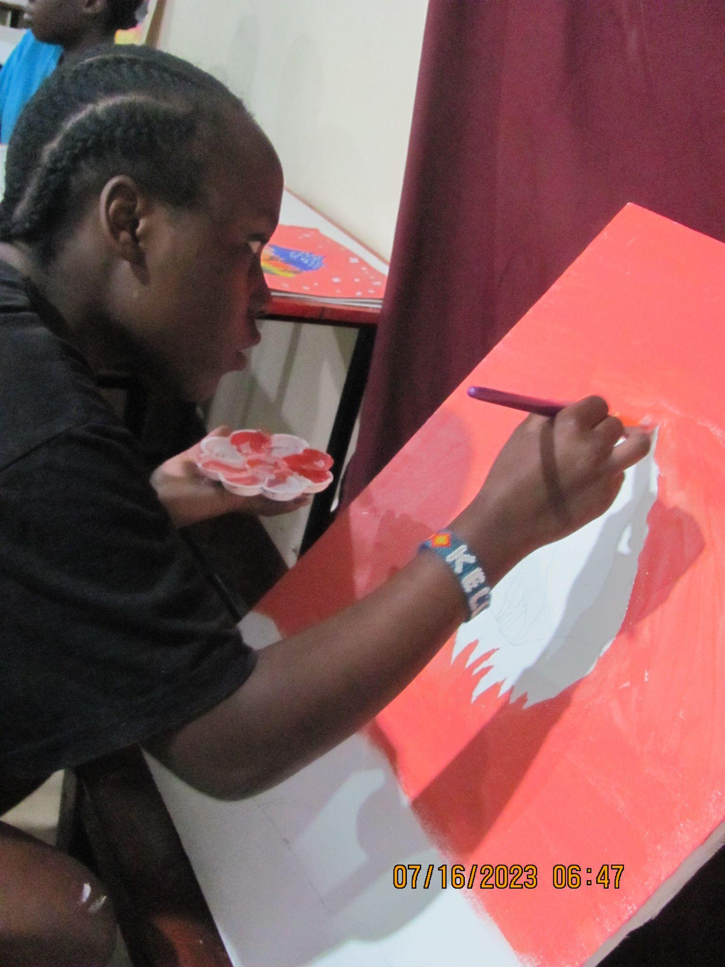

My Hobbies
I love cooking
Painting and drawing
Story telling

Slide 5

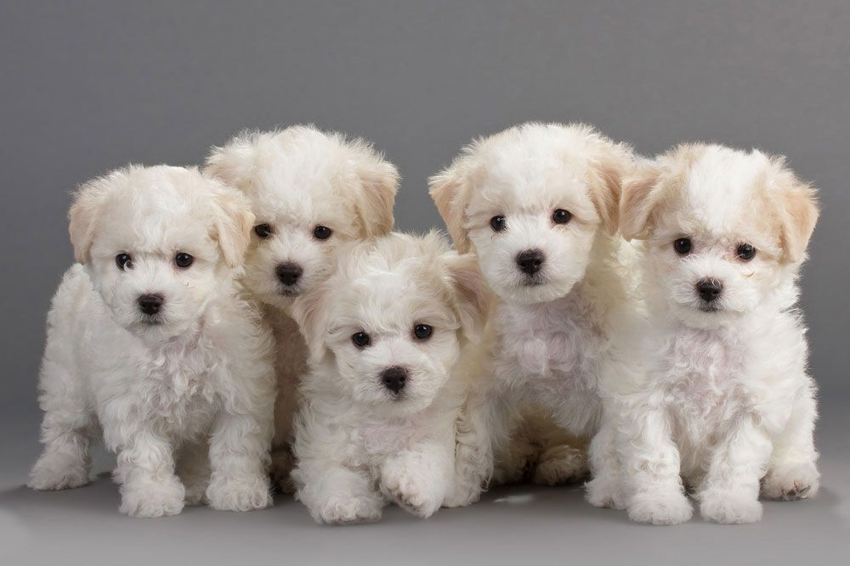
My Pet
Puppy

Slide 6
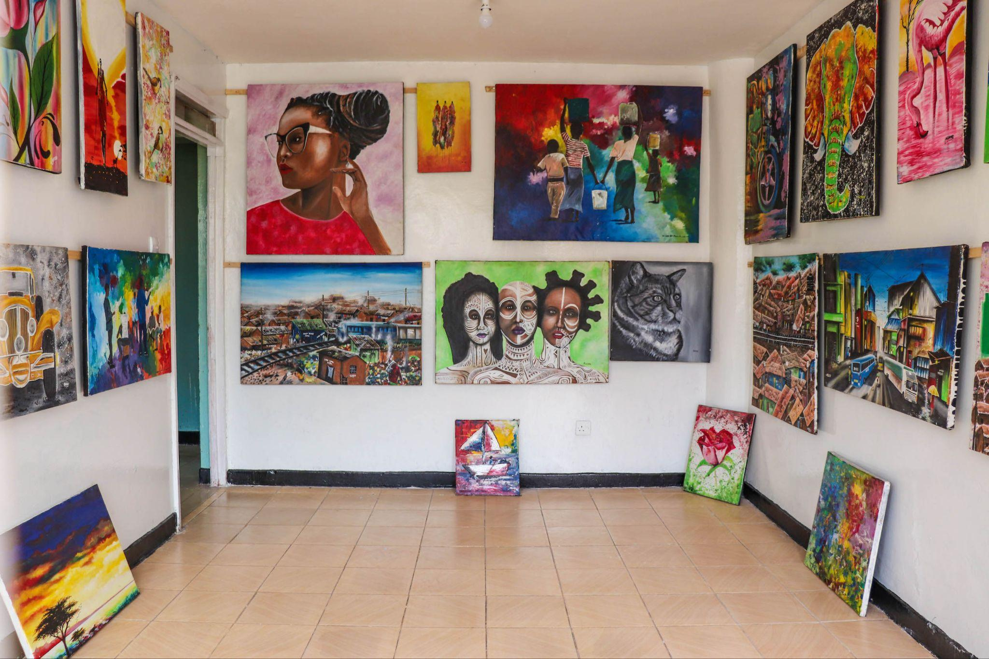
My Dream
My dream is to build an art school for
underprivileged children.

Slide 7
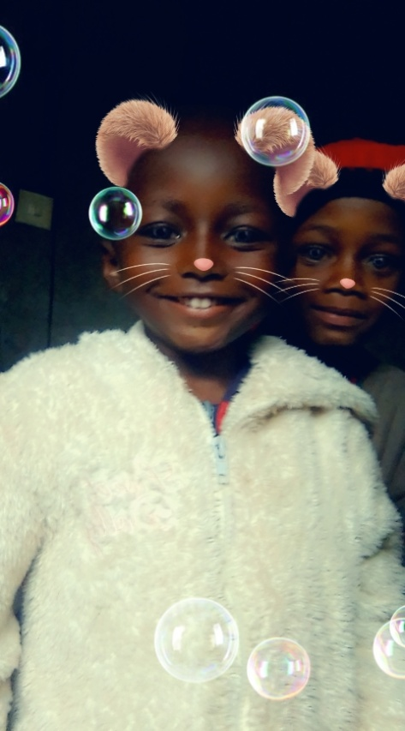
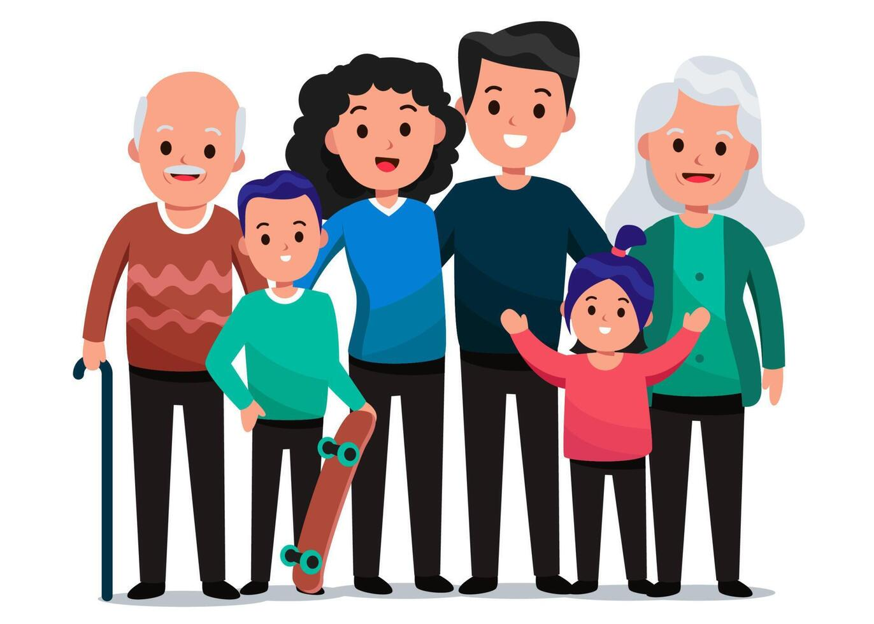
My Family
They are my source of strength and center of love.

Slide 8
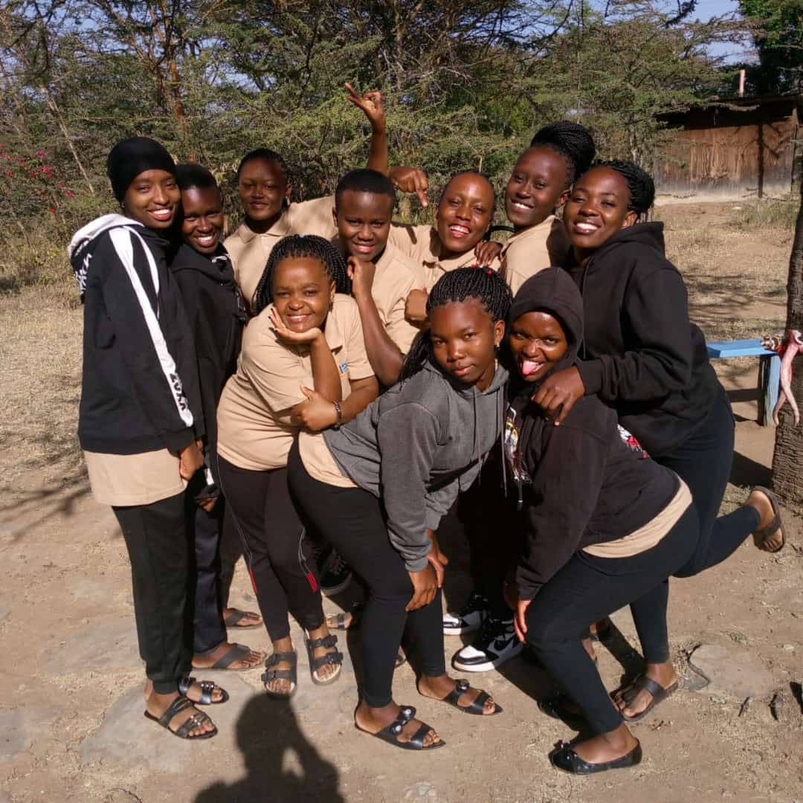
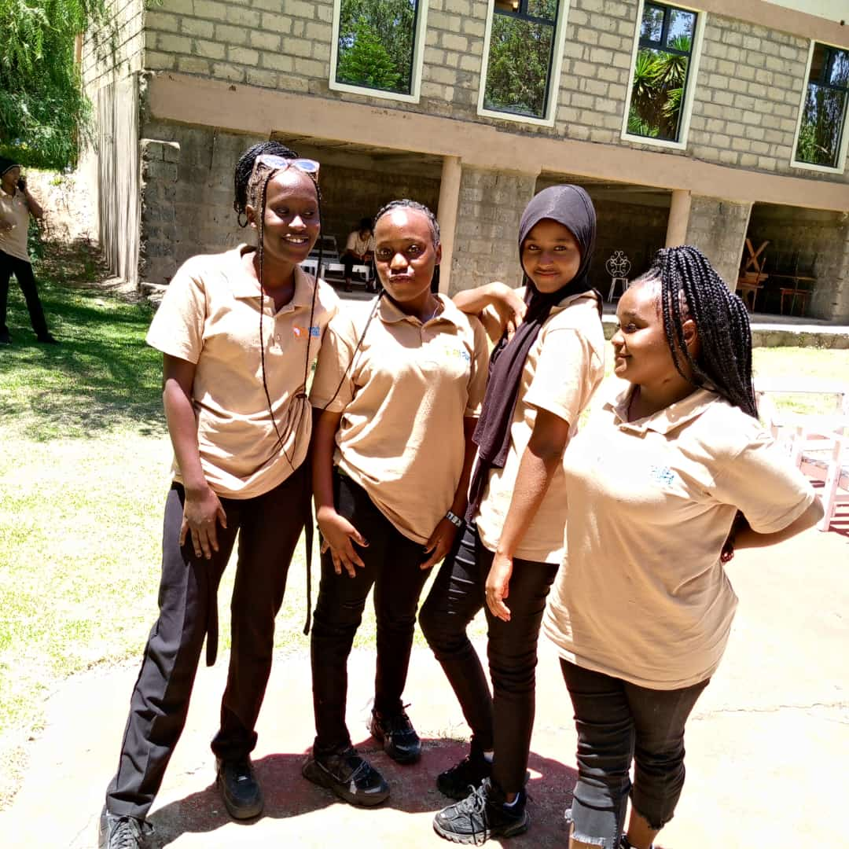
My friends
Friends for doing fun things and place
to share joy and sorrow.

Slide 9

Conclusion
Thank you everyone it was nice meeting you

